Slide 1
Building a Listening Eye
Automated lip reader
Siddharth Raja
John Turner

Slide 2
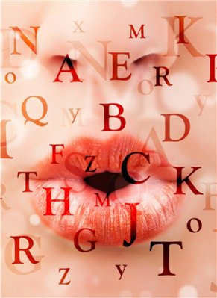
We aim to make a lip-reader that predicts what a person is saying solely by observing the individual's lip movements.

Slide 3
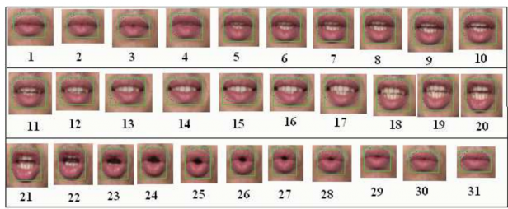
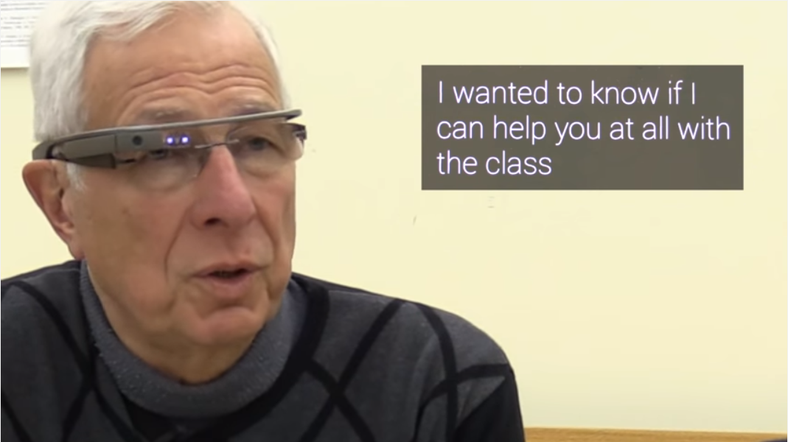
Motivation
It’s a hard problem
Under constrained (humans make more unique sounds than they do unique lip configurations in spoken English)
Humans also make use of visual cues to understand speech.
Provide Captioning or Generated Audio for situations where audio capture is impractical or nonexistent (for example, silent movies).
Assist the deaf
Example (captioning-on-glass)
https://www.youtube.com/watch?v=s5eXmShC3WE

Slide 4
Related Work
"Eigenlips" (1994) [1]
Hybrid approach of Multi-layered Perceptrons (MLP) and HMMs
Good accuracy but small dataset (around 2500 spoken letters)
"Extraction of visual features for lipreading" (2002) [2]
HMMs get 44.6% accuracy.
"Multimodal Deep Learning" (2011) [3]
Cross modality feature learning (audio & video)
"Long-term Recurrent Convolutional Networks" (2015) [4]
Combining CNNs and RNNs (LSTM nodes) to address video scene recognition
"Lipreading With Long Short-term Memory" (January 29 2016) [5]
Simple, single feed forward feeding LSTM layer to read lips from limited corpus. ~80%
[1] Bregler, C., & Konig, Y. (1994, April). “Eigenlips” for robust speech recognition. In Acoustics, Speech, and Signal Processing, 1994.
[2] Matthews, I., Cootes, T. F., Bangham, J. A., Cox, S., & Harvey, R. (2002). Extraction of visual features for lipreading. Pattern Analysis and Machine Intelligence, IEEE Transactions on, 24(2), 198-213.
[3] Ngiam, J., Khosla, A., Kim, M., Nam, J., Lee, H., & Ng, A. Y. (2011). Multimodal deep learning. In Proceedings of the 28th international conference on machine learning (ICML-11)
[4] Donahue, Jeffrey, et al. "Long-term recurrent convolutional networks for visual recognition and description." Proceedings of the IEEE Conference on Computer Vision and Pattern Recognition. 2015.
[5] Wand, Michael, et al. "Lipreading With Long Short-term Memory" (January 29 2016)

Slide 5
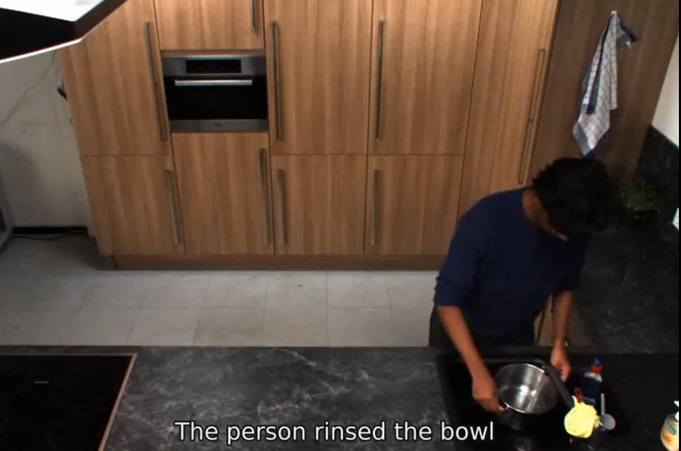

Slide 6
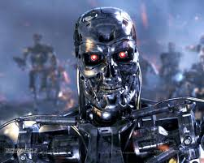
LSTM (Long Short Term Memory)
LSTMs are a kind of RNN used to capture important events with greater time lags of unknown duration
Used in handwriting recognition and other Sequence Learning Tasks
Outperform other HMMs and RNNs due to unconstrainted "memory"
Are Universal (Turing-complete), where their weights are "programs"
Updated via Backpropagation Through Time (BPTT).
Little computers than program themselves.

Slide 7
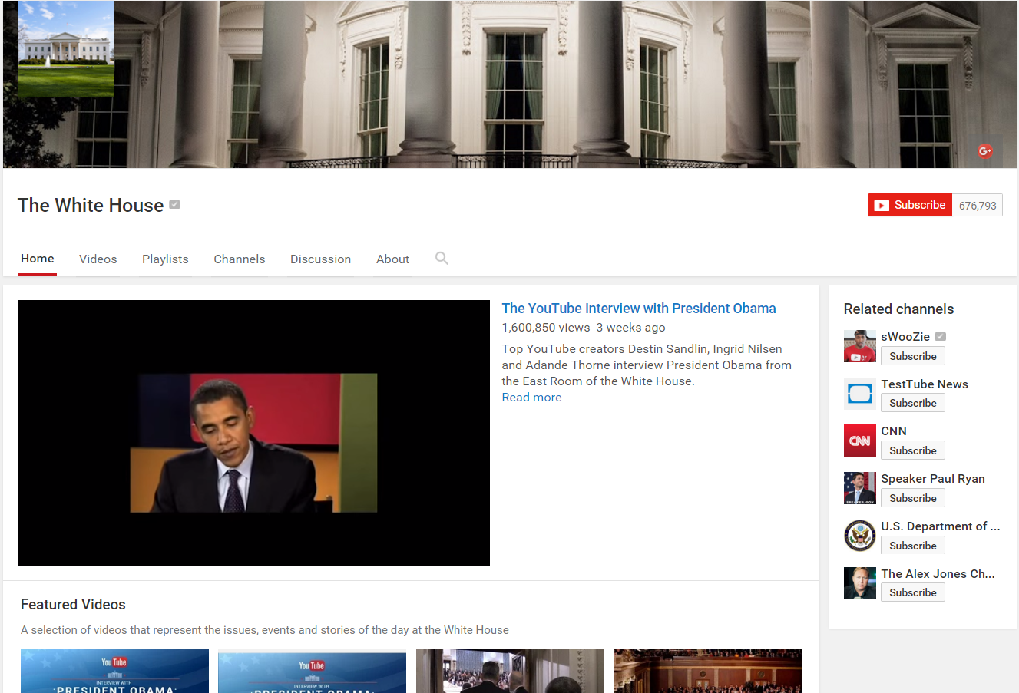
Data Sets
YouTube : Over 200 video clips from ‘The White House’ YouTube channel.
High Quality
Speaker centered frames
Public Domain data
Eloquent speaker
Thanks Obama!
GRID Dataset by University of Sheffield – but not a huge corpus (34 sentences, )
http://spandh.dcs.shef.ac.uk/gridcorpus/

Slide 8
Initial Approach
Acquire Training/Testing Data - Images and Words
Isolate the heads / mouths in talking head videos - Kanade-Lucas-Tomasi method to track head.
Capture Video and Audio samples.
Transcripts/Close Captioning.
Build Long-term Recurrent Convolutional Net
CN Feature Extractor.
LSTM-based layers that can learn temporal dynamics.
Varying Net topologies based on desired output.
Caption Output or Generative Output (i.e. generate audio samples)?

Slide 9
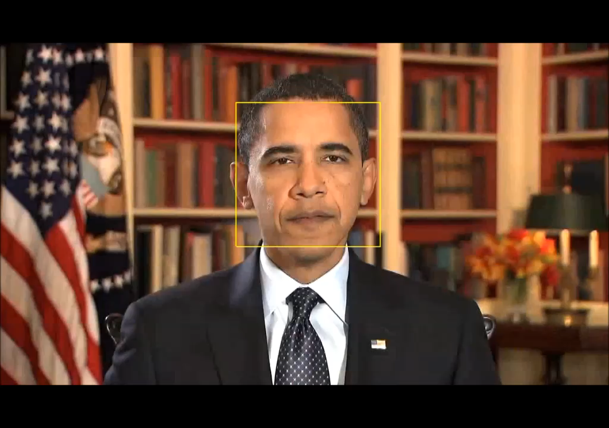

Slide 10
Thank You!
Questions?

